Slide 1
Introducción a Deep learning

Slide 2






Slide 3
Demo

Slide 4
Inteligencia Artificial
Machine learning
Deep learning

Slide 5
Inteligencia Artificial
Inteligencia artificial
-Strong (acts more like a brain)
-Weak (Siri, Alexa, conjunto limitado de tareas)
When a machine mimics "cognitive" functions such as "learning" and "problem solving”​
Any technique that enables computers to mimic human behavior

Slide 6
Machine learning
Inteligencia artificial
Machine learning
-Aprendizaje automatico
-Statistical techniques
Field of study that gives computers the ability to learn without being explicitly programmed.​
​
-Arthur Samuel​
Field of study that gives computers the ability to learn without being explicitly programmed.​
​
-Arthur Samuel​

Slide 7
Machine learning
Inteligencia artificial
Machine learning
-Aprendizaje automatico
-Statistical techniques
Subset of AI techniques which use statistical methods to enables machines to improve with experience

Slide 8
Deep learning
Inteligencia artificial
Machine learning
Subset of machine learning where artificial neural networks algorithms inspired by the human brain
Deep learning
-Fully connected neural network
-Feed forward neural networks
-Convolutional neural networks
Learn underlying features in data using neural networks
A Technique for Implementing Machine Learning

Slide 9
Tipos de machine learning
Supervised learning
Unsupervised Learning
Semi-supervised Learning
Reinforcement Learning

Slide 10
Supervised learning
K-nearest Neighbors
Linear Regression
Logistic Regression
Support vector Machines
Neural Networks

Slide 11
Supervised learning

Slide 12
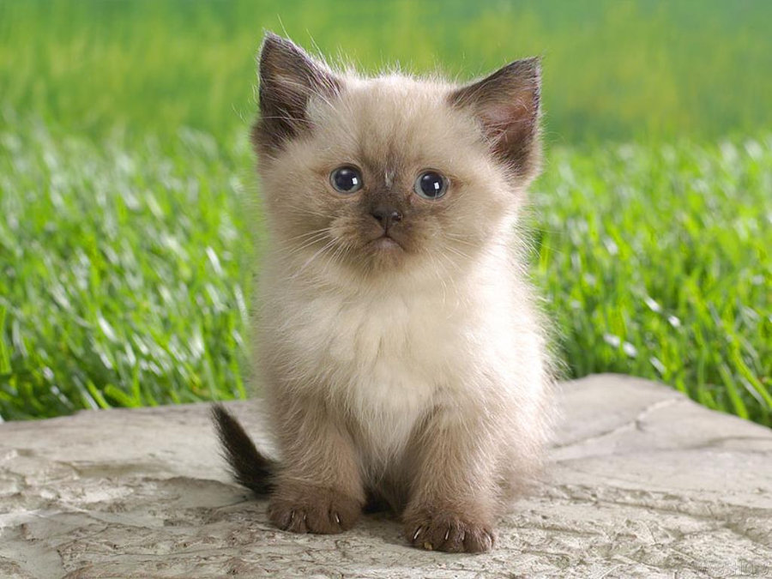
Supervised learning

Slide 13

Supervised learning

Slide 14

Supervised learning

Slide 15

Supervised learning
Input
Output
Cat

Slide 16
Supervised learning
Input
Output
Cat

Slide 17
Supervised learning
Input
Output
Cat

Slide 18
Supervised learning
Input
Output
NN
Cat

Slide 19
Unsupervised learning

Slide 20
Unsupervised learning

Slide 21
Unsupervised learning

Slide 22
Unsupervised learning
Clustering

Slide 23
Unsupervised learning
Clustering
-K-means
-Hierarchical cluster analysis
-Expectation Maximization
Visualization and dimensionality reduction
-Principal component analysis
-Kernel PCA
-Locally-Linear Embedding
Association rule learning
-Apriori
-Eclat

Slide 24
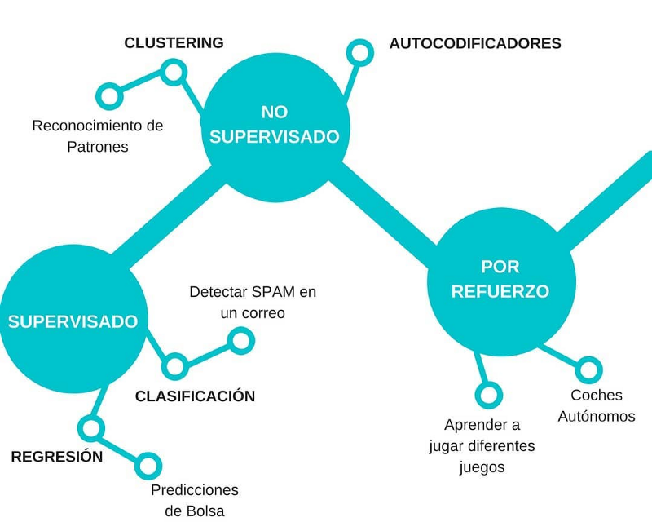
Tipo de machine learning

Slide 25
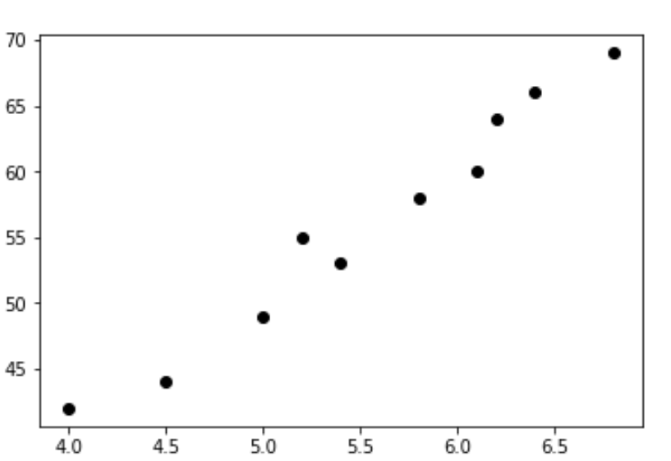
Linear regression
Salario
Experiencia

Slide 26
Linear regression
Salario
Experiencia

Slide 27
Linear regression
Salario
Experiencia

Slide 28
Linear regression
Salario
Experiencia

Slide 29
Linear regression
Salario
Experiencia

Slide 30
Linear regression
Salario
Experiencia

Slide 31
Linear regression
Salario
Experiencia

Slide 32
Linear regression
Salario
Experiencia

Slide 33
Linear regression
Salario
Experiencia

Slide 34
Linear regression
Salario
Experiencia

Slide 35
Linear regression
Salario
6.5
Experiencia

Slide 36
Linear regression
Salario
6.5
Experiencia

Slide 37
Linear regression
Salario
6.5
Experiencia

Slide 38
Classification

Slide 39
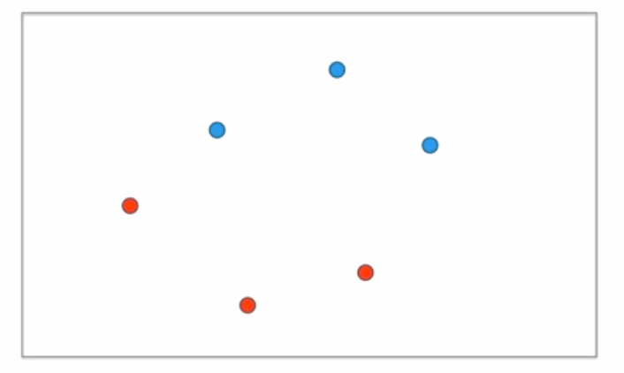
Classification

Slide 40
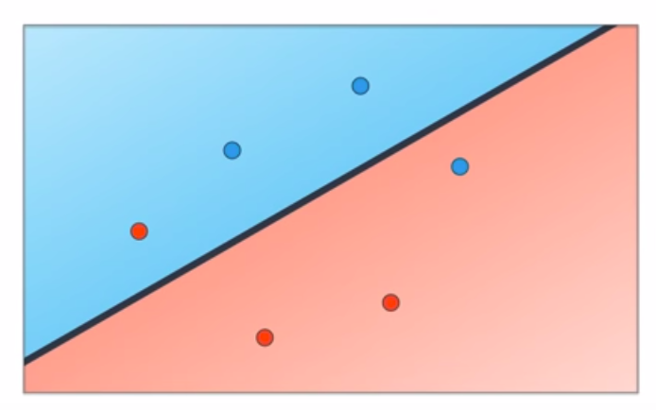
Classification

Slide 41
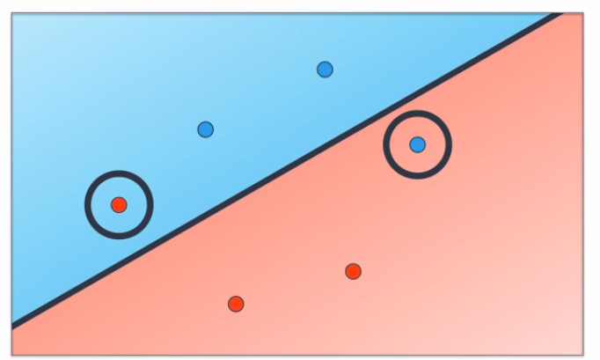
Classification

Slide 42
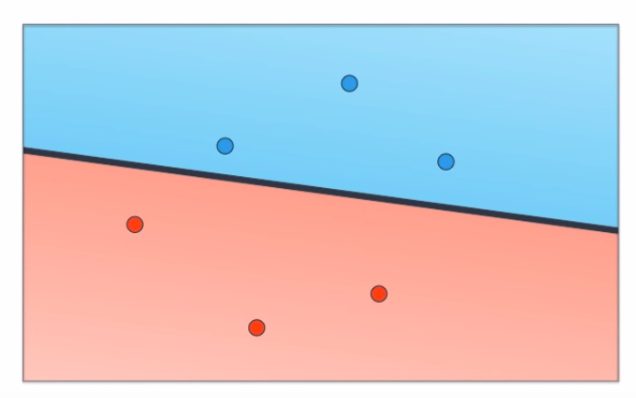
Classification

Slide 43
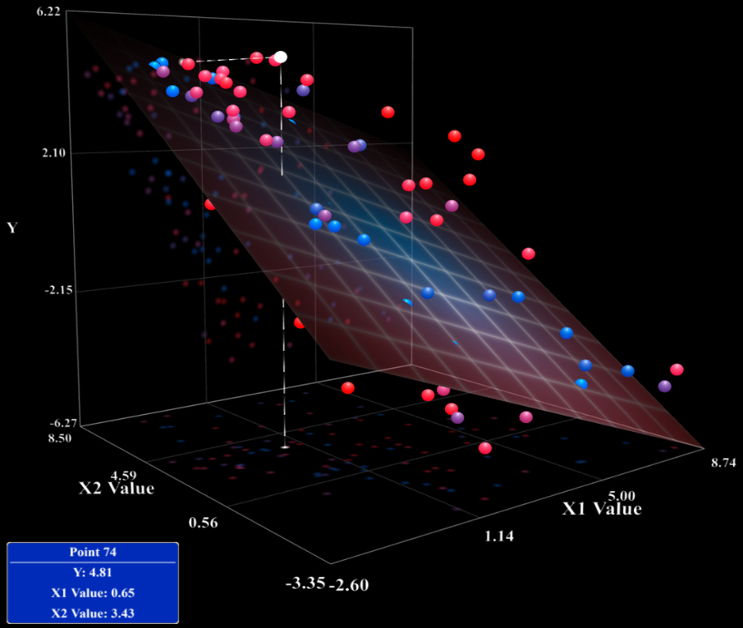
http://miabellaai.net/index.html

Slide 44
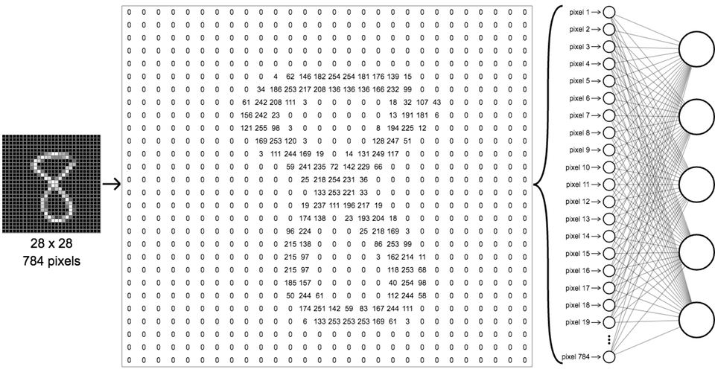

Slide 46
Linear regression
Y = wx + b
Salario
Experiencia

Slide 47
Linear regression
Y = wx + b
Salario
Experiencia

Slide 48
Linear regression
Y = wx + b
Salario
Experiencia

Slide 49
Linear regression
Y = wx + b
Salario
Experiencia

Slide 50
Linear regression
Y = wx + b
Salario
Experiencia

Slide 51
Linear regression
Y = wx + b
Salario
Experiencia

Slide 52
Linear regression
Y = wx + b
Salario
Experiencia

Slide 53
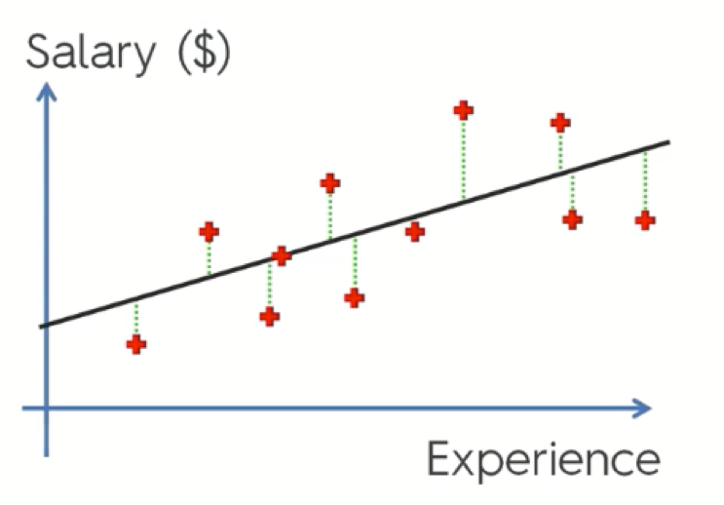
Linear regression

Slide 54
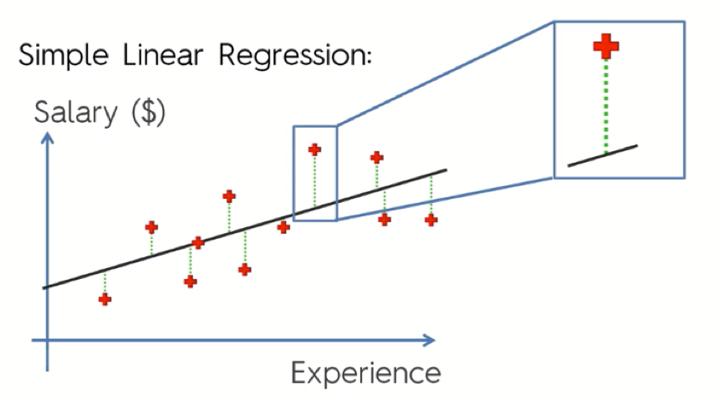
Mean Square Error

Slide 55
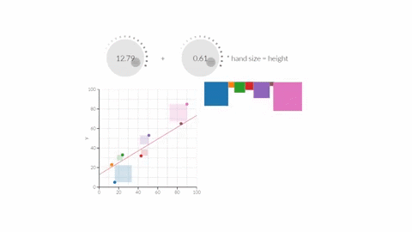
Linear regression

Slide 56
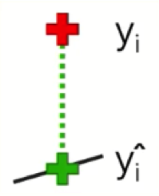
Mean Square Error

Slide 57
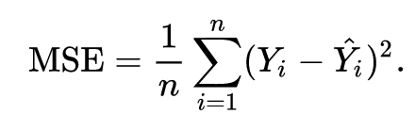
Mean Square Error

Slide 58
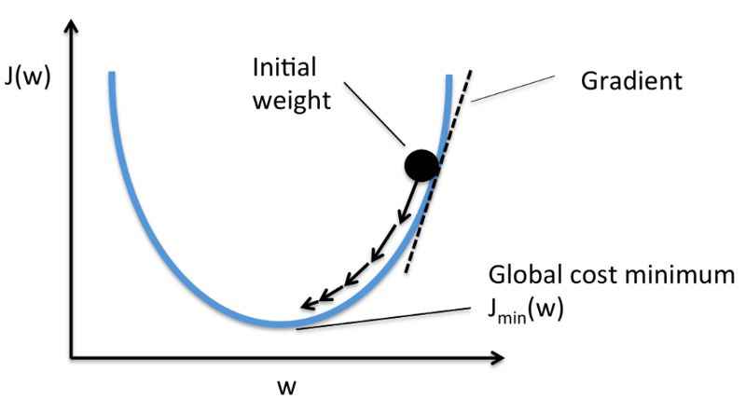
Gradient Descent
Gradient Descent is a general function for minimizing a function, in this case the Mean Squared Error cost function

Slide 59
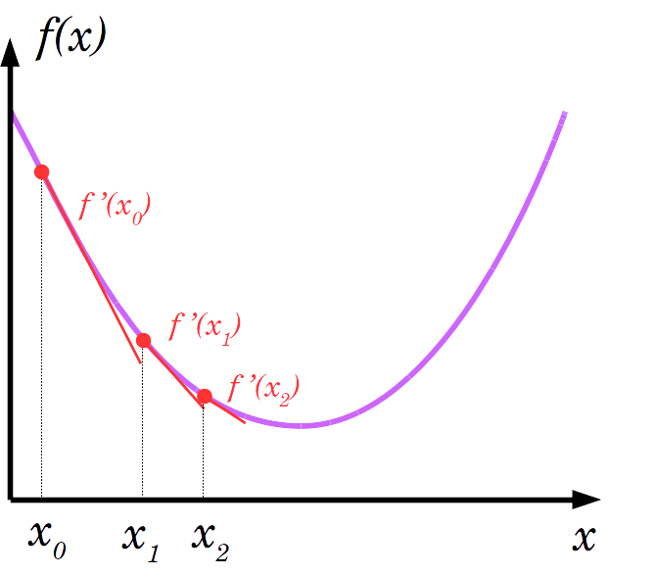
Gradient Descent
Gradient Descent is a general function for minimizing a function, in this case the Mean Squared Error cost function

Slide 60
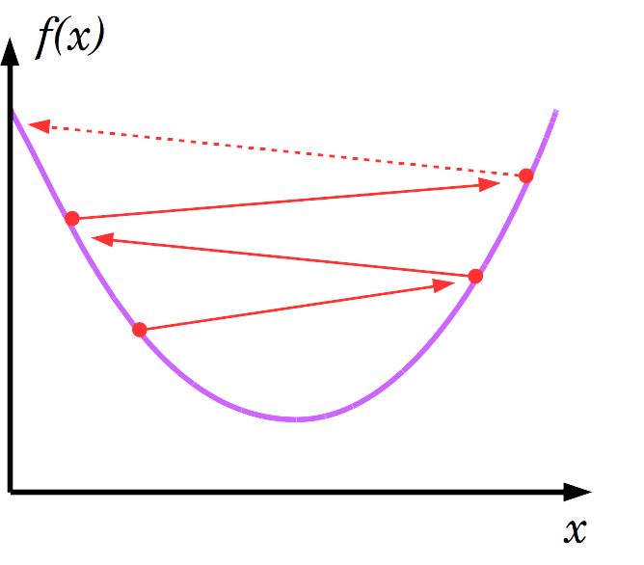
Gradient Descent
Gradient Descent is a general function for minimizing a function, in this case the Mean Squared Error cost function

Slide 61
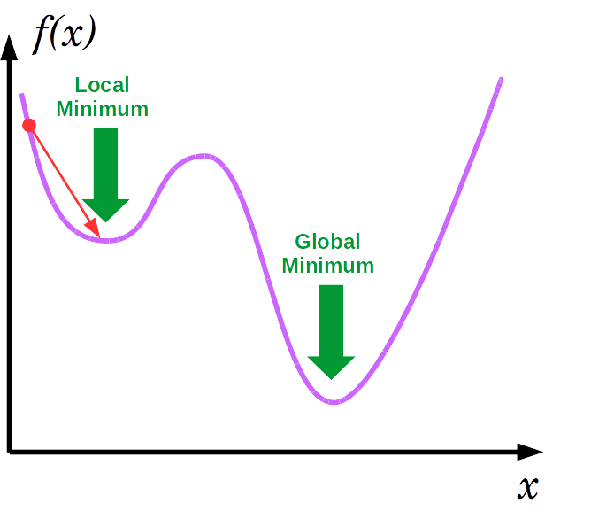
Gradient Descent
Gradient Descent is a general function for minimizing a function, in this case the Mean Squared Error cost function

Slide 62
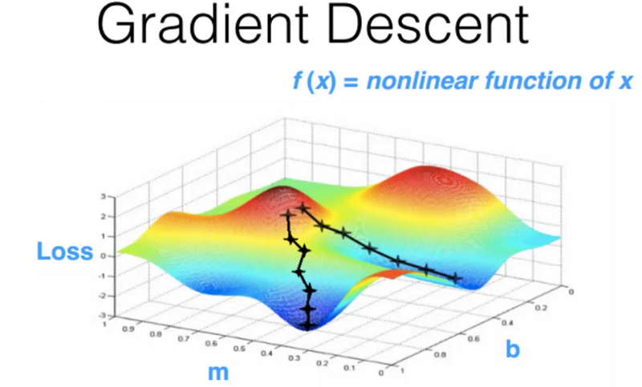

Slide 63
Activation functions
-Sigmoid function
-Hyperbolic Tangent
-Rectified Linear Unit
-Leaky ReLU

Slide 64

Sigmoid function

Slide 65
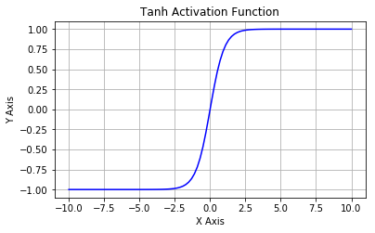
Hyperbolic Tangent

Slide 66
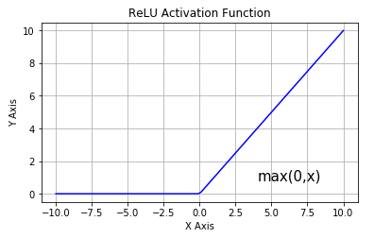
Rectified Linear Unit

Slide 67
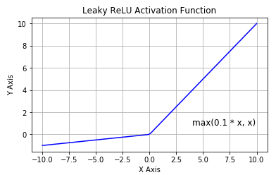
Leaky ReLU

Slide 68
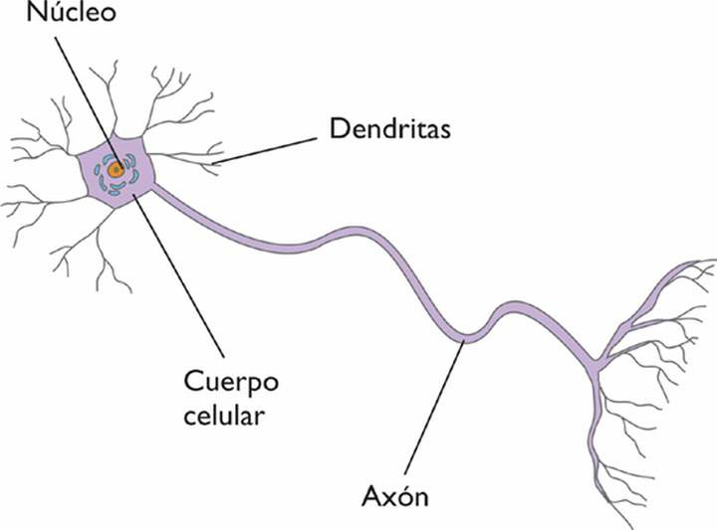
Neurona vs Perceptron

Slide 69
Perceptron

Slide 70
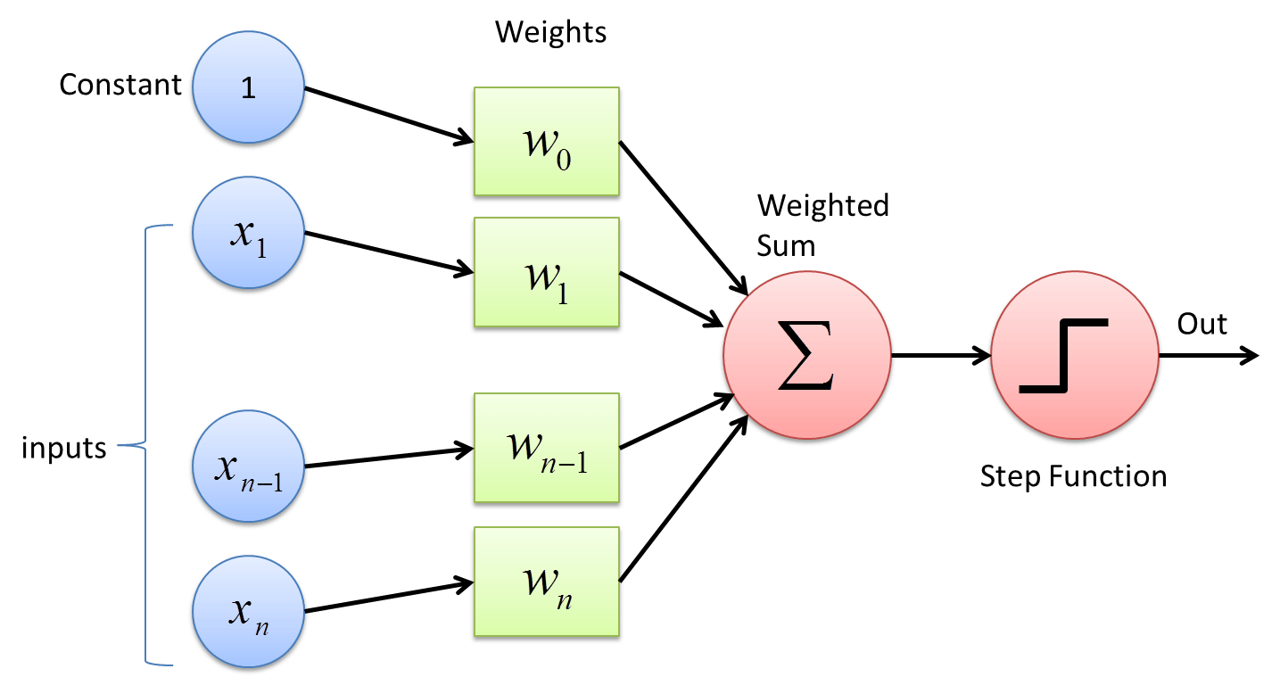
Perceptron

Slide 71
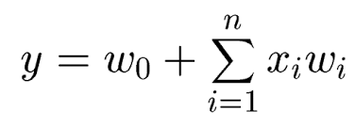
Perceptron

Slide 72
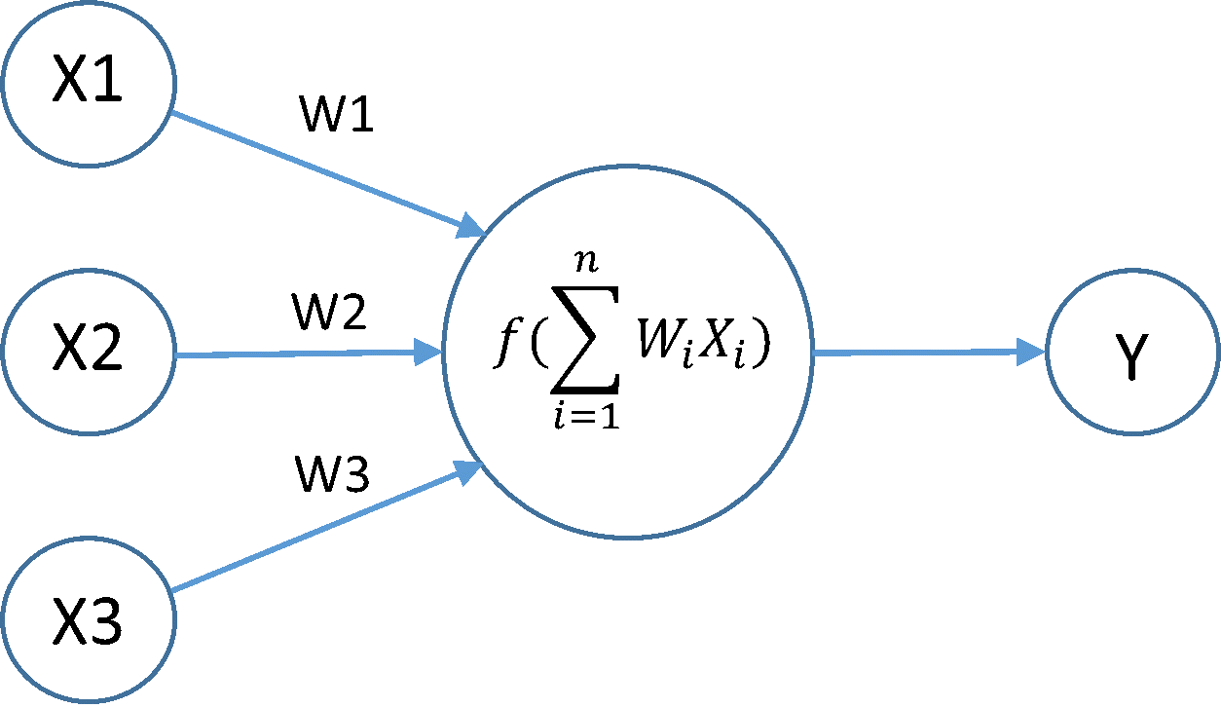
Perceptron

Slide 73
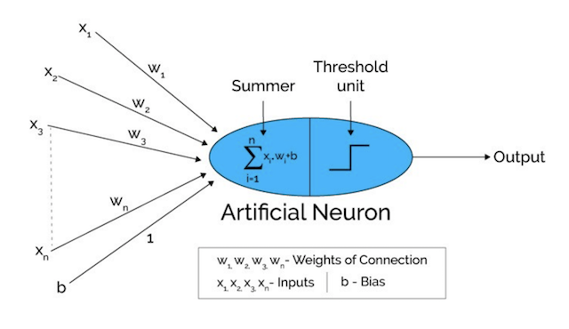
Perceptron
Activation function

Slide 74
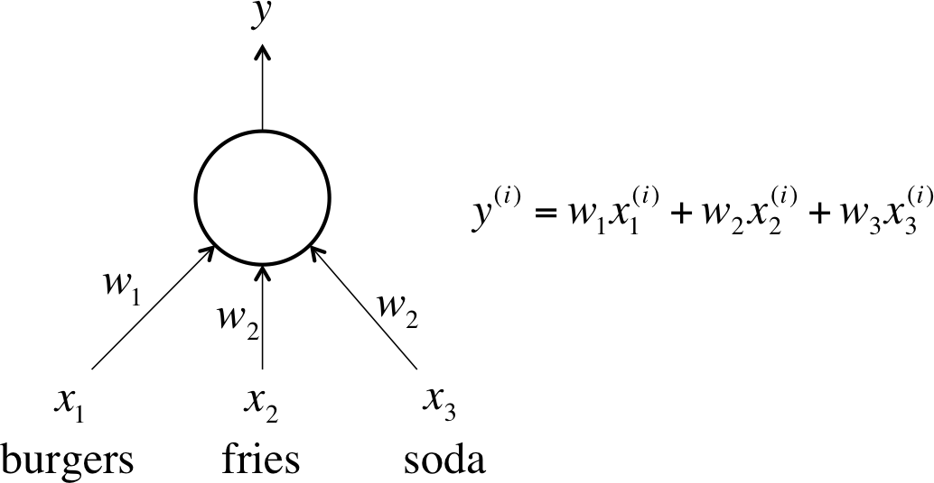
Perceptron

Slide 75
Perceptron

Slide 76
Perceptron

Slide 77
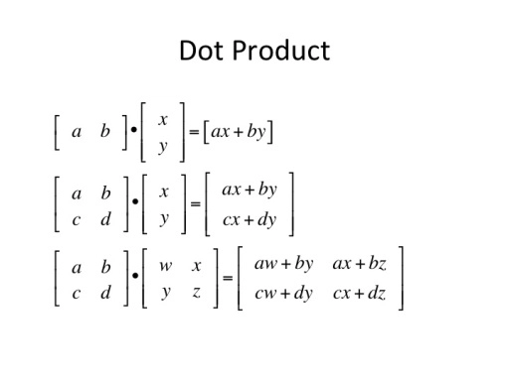

Slide 78
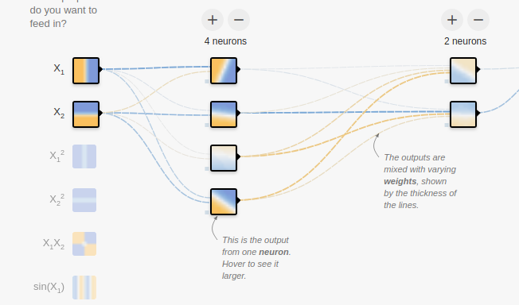
https://playground.tensorflow.org/

